Slide 1
Getting Data from the Web: Scraping the web

Slide 2
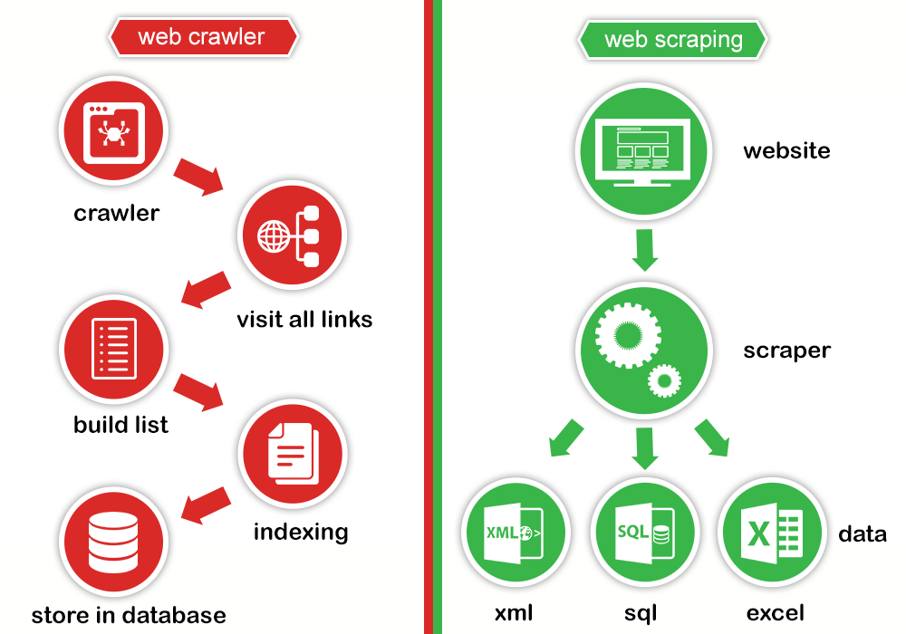
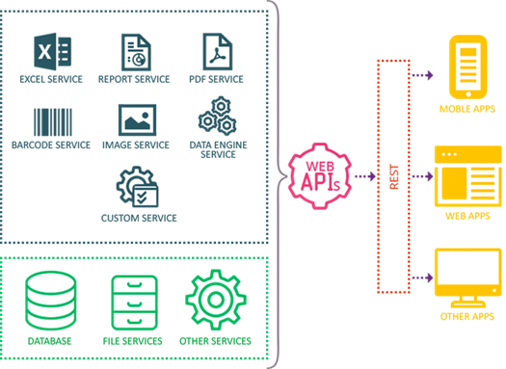
Web scraping vs API
2 ways of capturing data from the Internet
(application programming interface)
Web Scraping/HTML Parsing
The data source eases our access to the data through a well documented protocol
Makes the call for us (the author is “allowing us” to access the data and has created a logical interface to serve the data to us)
Use HTTP requests and parse returned HTTP responses (HTML, XML,etc) to scrape relevant information
Scraping gives you scale
Notes:
Imagine for a second Google founders creating the first version of their search engine used a web form that every webmaster had to fill, and update, with content from the website in order for the text of this page to be indexed by Google
Can you imagine the incredible amount of time and effort required to explain the vision and convince people to get involved in this process?
Even if the market was starving for an excellent search engine (as it proved to be the case), this engine wouldn't be Google because its growth would be extremely slow. Even the most sophisticated algorithms wouldn't be able to offset the lack of data.
For that reason, Google decided to use automated web crawlers that move through links from page to page, filling their massive databases.

Slide 3
What’s the difference what’s the difference between web scraping and web webcrawling?
Both terms are often used interchangeably
Let's first define these terms to make sure that we're on the same page.
Web scraping: the act of automatically downloading a web page's data and extracting very specific information from it. The extracted information can be stored pretty much anywhere (database, file, etc.).
Web crawling: the act of automatically downloading a web page's data, extracting the hyperlinks it contains and following them. The downloaded data is generally stored in an index or a database to make it easily searchable.

Slide 4
What is Web Scraping?
You might want to collect and analyze data related to a specific category from multiple websites: real estate, automobiles, electronic gadgets, industrial equipment, business contacts, marketing etc.
The different websites which belongs to the specific category displays information in different formats. Even with a single website you may not be able to see all the data at once. The data may be spanned across multiple pages (like google search results, known as pagination or paginated lists)
Web scraping is a way of systematically pulling information from one or several websites
A Web Scraper will help you gather structured data from multiple unstructured sources in the Internet with ease
Allows you to simulate a human viewing the page and copying information to a table
Pull data based upon finding patterns in the structured data
For instance, using a Web Scraper you can
scrape product details (price, images, rating, reviews etc) from retailer/manufacturer/eCommerce websites (Ex: Amazon, eBay, etc.)
Collect product/service reviews to do sentimental analysis
Scrape people profiles from social networks
Scrape business profiles and reviews to track online presence and reputation
Scrape search engine results for SEO tracking
Scrape news articles to monitor economic/social/political phenomena
Monitor specific company pages from social networks to gather what people are saying about certain companies and their products
Scrape information on the web to provide better targeted ads to customers

Slide 5


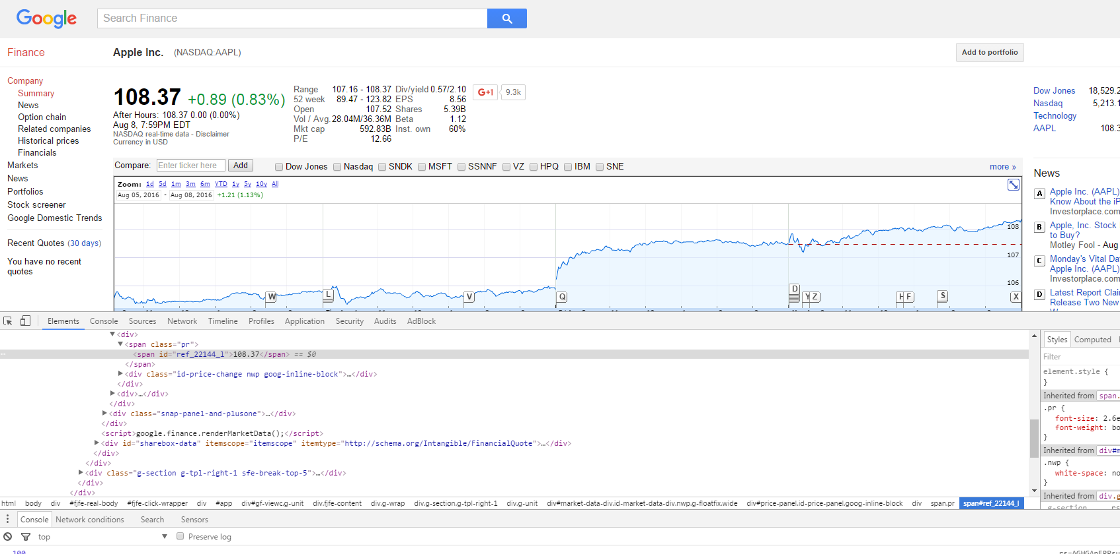
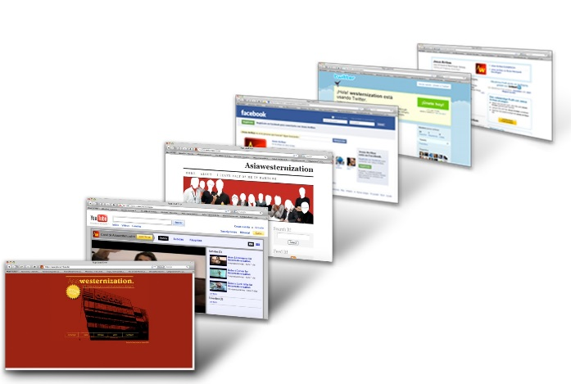

Basically you need to find relevant HTML attributes (ids, classes, etc) that point to the data of interest
https://www.google.com/finance?cid=22144
Obviously web scraping usually involves scraping at a large scale
From the same domain
From different domains
But be careful… you can get blocked if you generate too many HTTP requests to a domain!
Notes:
Use Perhaps appropriate regex to capture target

Slide 6
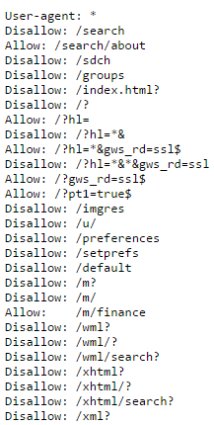

Robots.txt
The robots exclusion standard allows website owners to specify whether they allow web “robots” or not
This information is located in the root directory of a website and called “robots.txt”
“www.google.com/robots.txt”
The file tells web robots/bots/spiders/crawlers (aka your script) whether you are allowed to scrape a website or not
It works likes this: a robot wants to visit a Web site URL, say http://www.example.com/section
Before it does so, it firsts checks for http://www.example.com/robots.txt, and finds:
Notes:
There are two important considerations when using /robots.txt:
Robots/spiders/crawlers can ignore your /robots.txt.
Especially malware robots that scan the web for security vulnerabilities, and email address harvesters used by spammers will pay no attention.
the /robots.txt file is a publicly available file. Anyone can see what sections of your server you don't want robots to use.
So don't try to use /robots.txt to hide information.
Things to look for
User-agent: what type of robots do the following rules apply to
Disallow: what parts of the website are you not allowed to scrape
Notice that you may be able to scrape parts of the website but not others
Read more: http://www.robotstxt.org/robotstxt.html

Slide 7
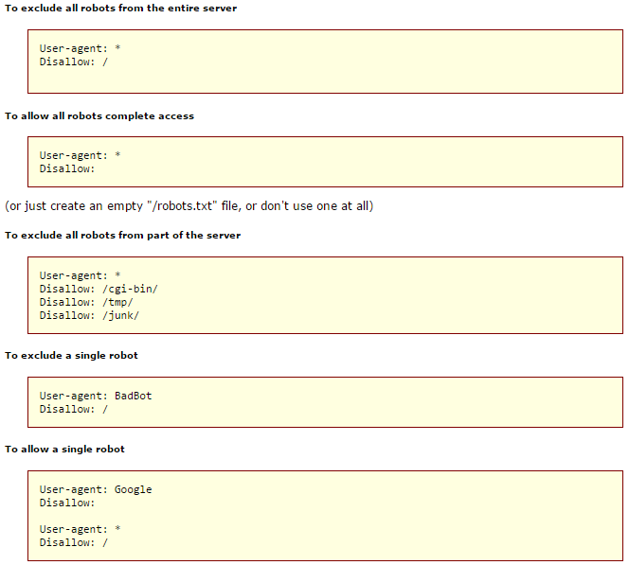
Robots.txt

Slide 8
How to do web scraping manually
Two libraries to help us create raw web scraping robots with Python
Request
Beautiful Soup
Requests “gets” the webpage’s HTML from the web using the URL
Using HTTP requests
Beautiful Soup changes the HTML into a searchable, structured object which you can then manipulate
-sort of like the DOM in JavaScript

Slide 9

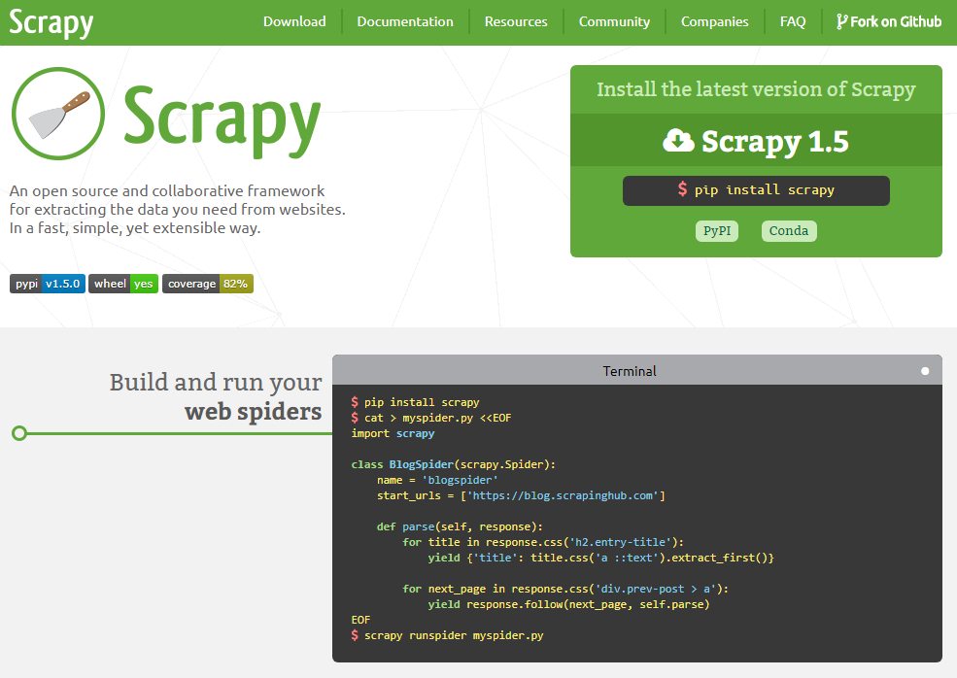
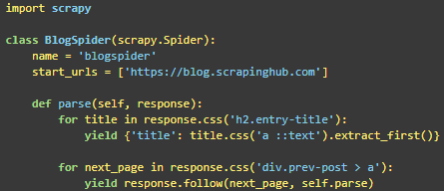
Scrapy is an open source framework for creating spiders that extract the data you need from various sources (websites, APIs,etc)
In my opinion, a better alternative to using Requests and BeautifulSoup
Event-based architecture (single thread, like node.js)
Disconnect latency from throughput
Operates smoothly while having thousands of connections open concurrently (in parallel)
Slow or unpredictable websites, databases or remote APIs won’t have devastating consequences on your scrapers performance
Allows cascading operations (pipelines) that clean, form, and enrich the data, store them in databases and so on while enjoying low degradation in performance
https://scrapy.org

Slide 10
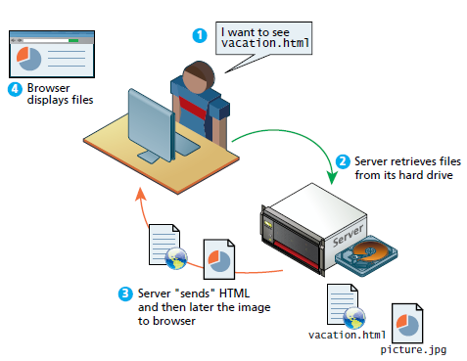
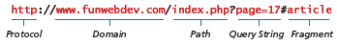
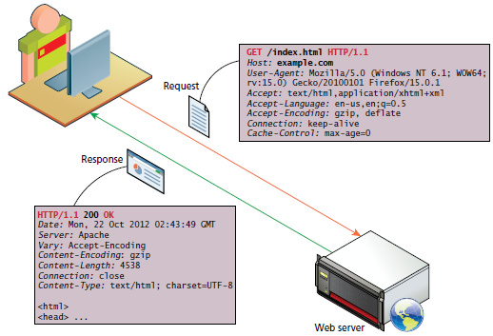
Review of web technologies
URLs
It consists of two required components:
the protocol used to connect
the domain (or IP address) to connect to
An optional components:
Port:
Path
Query string
Fragment
HTTP request methods
Headers are sent in the request from the client
HTTP response codes
Headers are received in the response from the server
Headers encode the parameters for the HTTP transaction
Notes:
HTTP request headers include data about the client machine:
Host: allows multiple websites to be hosted of the same IP address
User – agent: informs what kind of operating system and browser the user is running
Accept: informs the server what kind of media types the client can receive in the response
Accept – encoding: informs the server what type of modifications can be done data before transmission ( the browser can specify if it can unzip compressed files)
Connection: specifies to the server whether it should keep the connection open or close it after response
Cache control: allows the client to control download of data according to certain constraints
HTTP response headers include data about the server machine:
Response codes
Server: tells the client about the server operating system and software
Last modified: information about when the requested resource last changed (this allows caching mechanism at the client)
Content length: specifies how large the response body will be (so the browser can then allocate an appropriate amount of memory to receive the data)
Content type: informs the browser what type of data is attached to the body of the message ( HTML, JPEG, PNG, XML…)
Content encoding: specifies to the client how the content was encoded so that it can be decompressed if need be

Slide 11
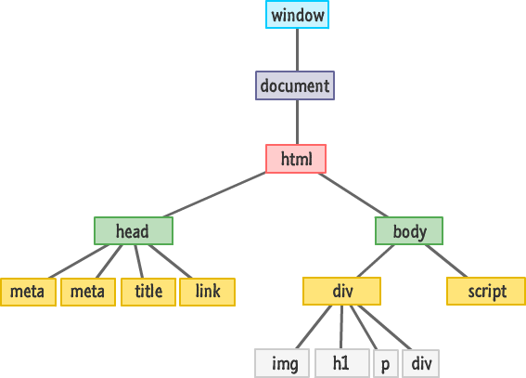
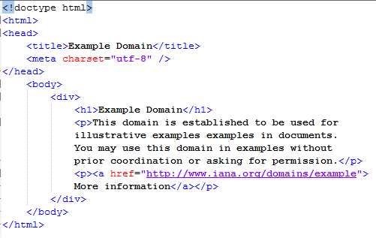
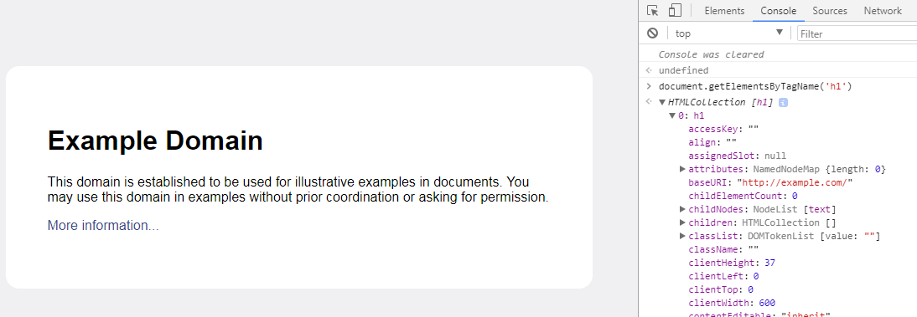
The HTTP response body, usually HTML, is represented by the browser with a data structure known as: The DOM
Every browser has its own, complex internal data structures with the aid of which it renders web pages. The DOM representation is cross-platform and languageindependent,
and is supported by most browsers.
Notes:
Note that HTML has a naturally hierarchical structure
The <html> is the root node, and it contains two children, head and body. They in turn contain children. For example, the body can have two children, an h1 and a <p>. The p can have children of its own, a text fragment, an <i> (itself an element containing one text fragment child) and another text fragment for instance.
Note that leaf nodes are always content: text, an img or an input control. Internal nodes below the html node are always html elements.
Working with the DOM involves selecting elements of this tree, traversing this tree, processing elements of this tree, and adding and deleting elements from this tree.
Each time you modify the DOM (the structure and/or the content), the browser re-renders it. No server contact to get fresh HTML is required

Slide 12
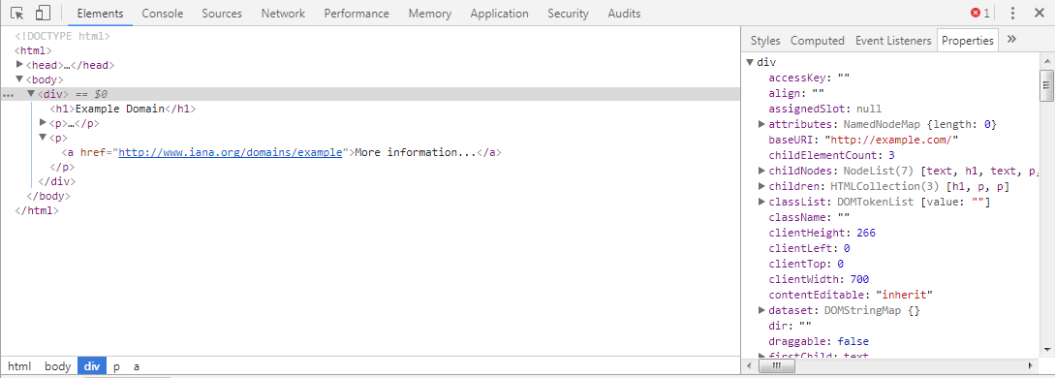
The DOM
To see the hierarchical tree representation of a web page in Chrome, right-click on the element you are interested in, and select Inspect Element
At this point, you see something that looks very similar to the HTML representation, but it's not exactly the same. It's a tree representation of the HTML code
You can click on every element to inspect or manipulate attributes, and such, and see how these changes affect what you see on the screen in real time.
On the right, under the Properties tag, you can see the properties of this tree representation, and at the bottom, you can see a breadcrumb-like structure that shows the exact position of your currently selected element in the hierarchy of HTML elements.
http://example.com

Slide 13
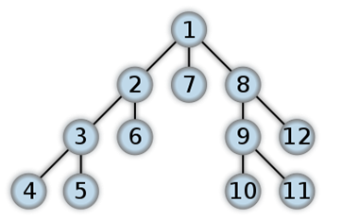
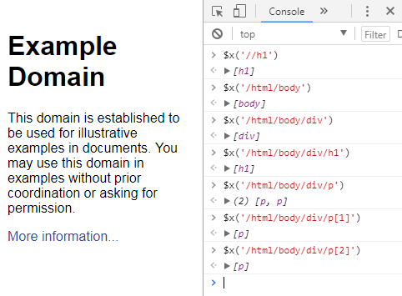
XPath
Xpath is a language to navigate tree data structures
You can select and extract elements, attributes, and text from HTML documents with Xpath
More expressive than CSS
/ syntax allows you to specify a route
//syntax allows you to get elements of a particular type no matter where they are in the hierarchy
You will find it very useful to select elements that have a specific attribute, such as @class, or that have a specific value as an attribute.
//a[@href] selects all links that contains href attribute
//a[@href="http://www.iana.org/domains/example"] selects links that have an attribute href with the specified value.
You can also select just the text in the element by using the text() function
//a[@href]/text()
You can use the * character to select all elements at a specific hierarchy level
Tutorials:
https://doc.scrapy.org/en/xpath-tutorial/topics/xpath-tutorial.html
http://plasmasturm.org/log/xpath101/

Slide 14
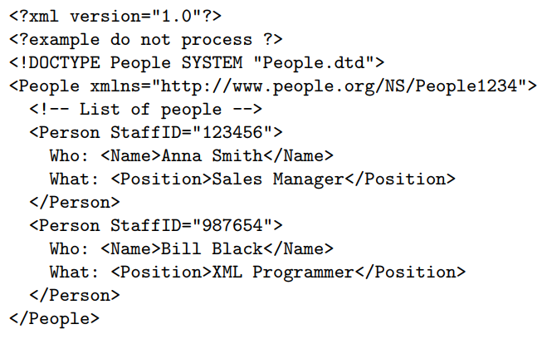
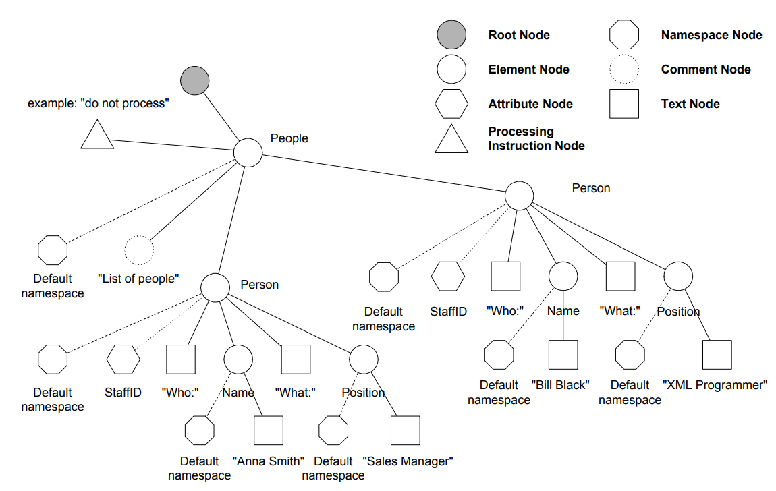
Xpath node tree

Slide 15
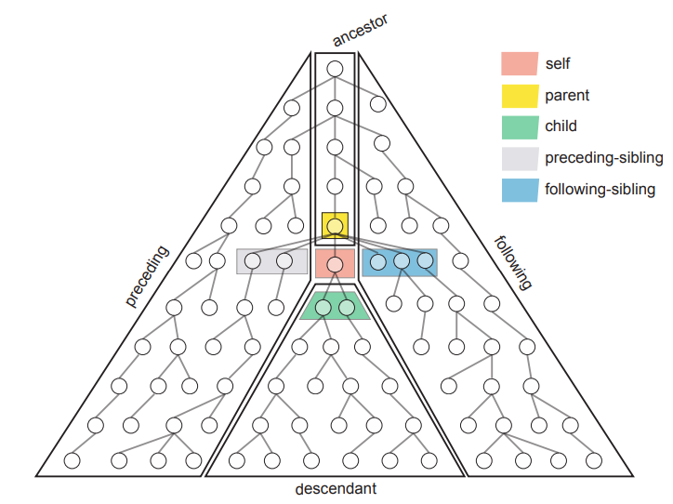
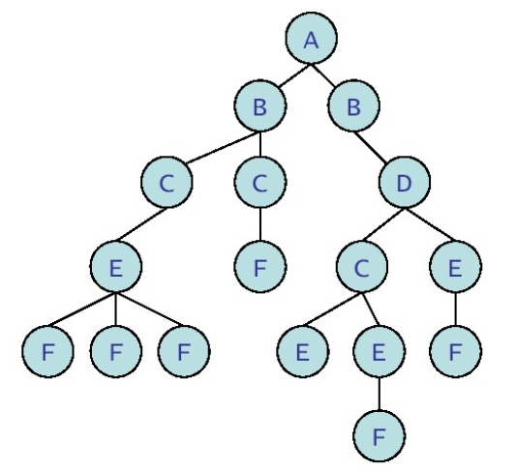
XPath
Starting from the context note, a location path returns a node set
Each node of this node set becomes in turn the context note for evaluating the next step
General syntax of a location step:
Axis::node test[qualifier]
//C/E/F[last]
descendant::C/child::E/child::F[last]

Slide 16
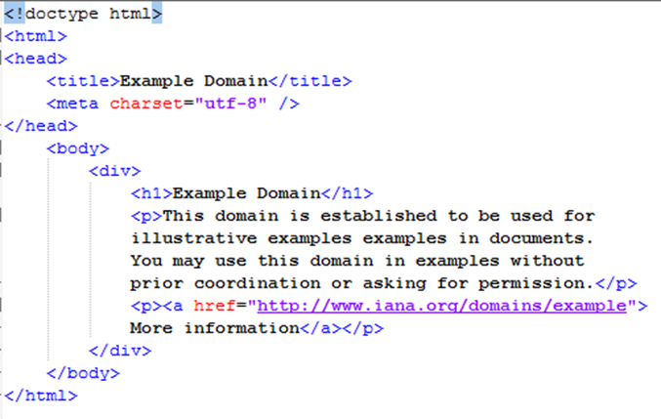
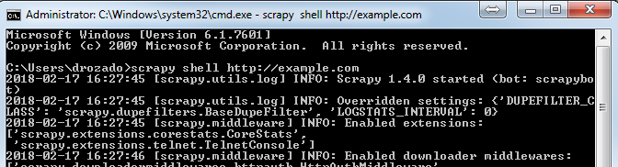
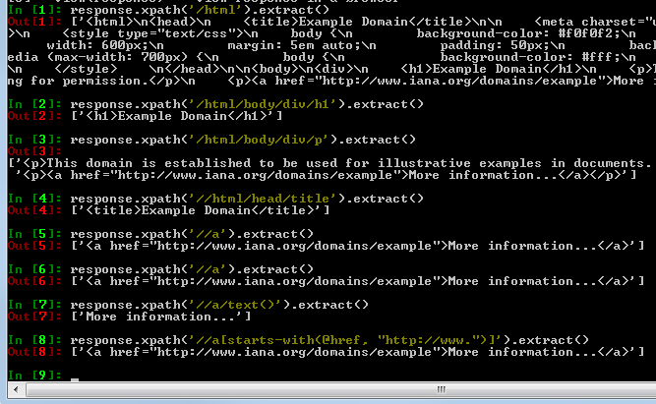
Use XPath expressions in a Scrapy shell
The shell gives you access to many variables that are typically available when you write spider code.
The most important of them is response, which is an HtmlResponse in case of HTML documents
Notes:
Examples of common tasks
Getting the text of the span under the div with id "firstHeading":
//h1[@id="firstHeading"]/span/text()
Getting the URLs of links in an unordered list (ul) inside a div with id "toc":
//div[@id="toc"]/ul//a/@href
Getting the text anywhere inside a header element (h1) inside any element with a class attribute containing "ltr" and a class attribute containing "skin-vector". The two strings may be in the same class or different ones.
//*[contains(@class,"ltr") and contains(@class,"skin-vector")]// h1//text()
To select the URL for the first image in the table that has a class attribute with value "infobox", use the following:
//table[@class="infobox"]//img[1]/@src
To select all the URLs of the links under the div with a class attribute that starts with "reflist":
//div[starts-with(@class,"reflist")]//a/@href
To select all the URLs of links under the div element following an element whose child element contains the text "References":
//*[text()="References"]/../following-sibling::div//a
To select the URL for the first image in the table that has a class attribute with value "infobox", use the following:
//table[@class="infobox"]//img[1]/@src
To select all the URLs of the links under the div with a class attribute that starts with "reflist":
//div[starts-with(@class,"reflist")]//a/@href
To select all the URLs of links under the div element following an element whose child element contains the text "References":
//*[text()="References"]/../following-sibling::div//a
To get the URLs for every image on the page:
//img/@src

Slide 17
Using Chrome to get XPath expressions
Chrome acts even more developer-friendly by giving us basic XPath expressions. Start by inspecting an element as shown earlier: right-click on the desired element, and then choose Inspect Element.
This opens Developer Tools and the HTML element in the tree representation will be highlighted. Now right-click on it, and select Copy XPath from the menu; the XPath expression will be copied to the clipboard
Unfortunately, this method does not always work smoothly

Slide 18
UR²IM – the fundamental scraping process

Slide 19
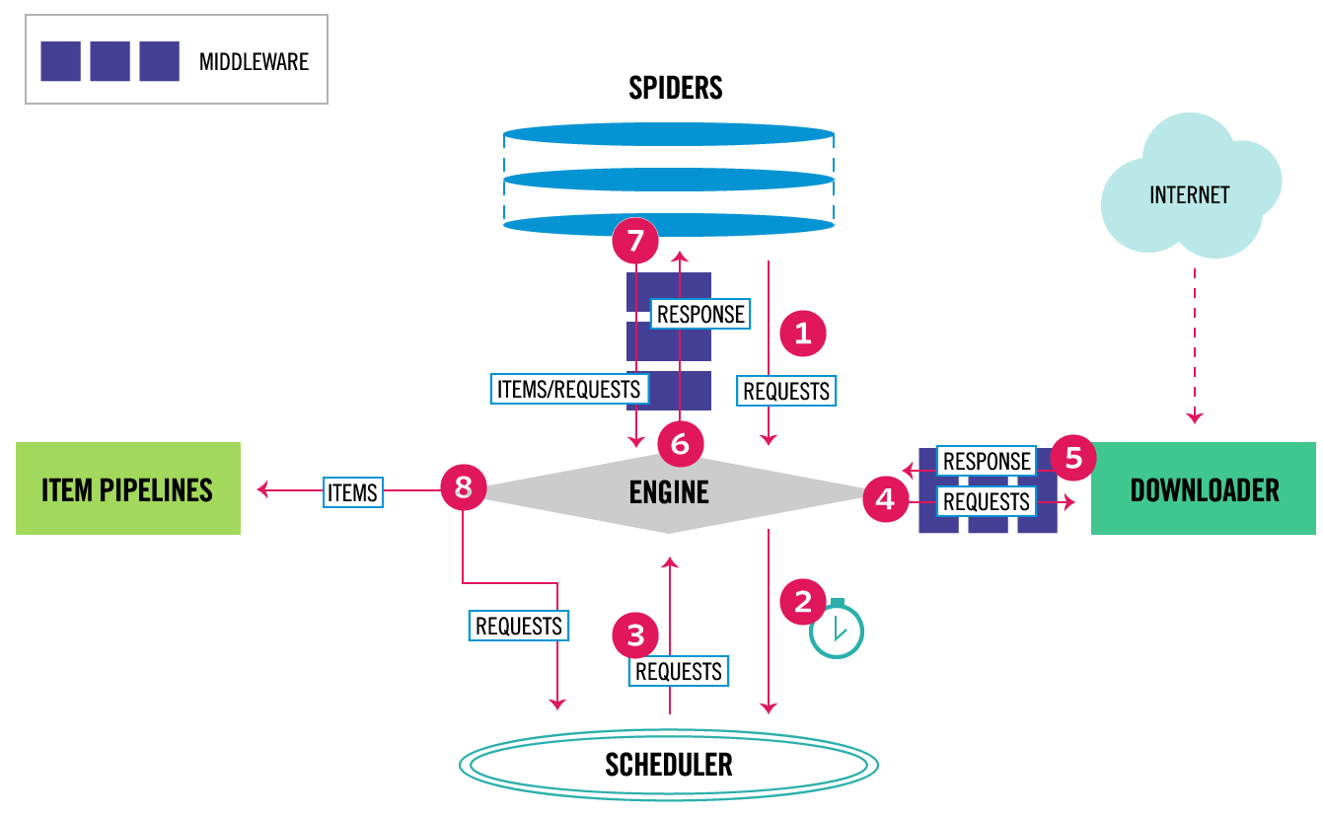
Scrapy Architecture overview
Notes:
The data flow in Scrapy is controlled by the execution engine, and goes like this:
The Engine gets the initial Requests to crawl from the Spider.
The Engine schedules the Requests in the Scheduler and asks for the next Requests to crawl.
The Scheduler returns the next Requests to the Engine.
The Engine sends the Requests to the Downloader, passing through the Downloader Middlewares (see process_request()).
Once the page finishes downloading the Downloader generates a Response (with that page) and sends it to the Engine, passing through the Downloader Middlewares (see process_response()).
The Engine receives the Response from the Downloader and sends it to the Spider for processing, passing through the Spider Middleware (see process_spider_input()).
The Spider processes the Response and returns scraped items and new Requests (to follow) to the Engine, passing through the Spider Middleware (see process_spider_output()).
The Engine sends processed items to Item Pipelines, then send processed Requests to the Scheduler and asks for possible next Requests to crawl.
The process repeats (from step 1) until there are no more requests from the Scheduler.

Slide 20
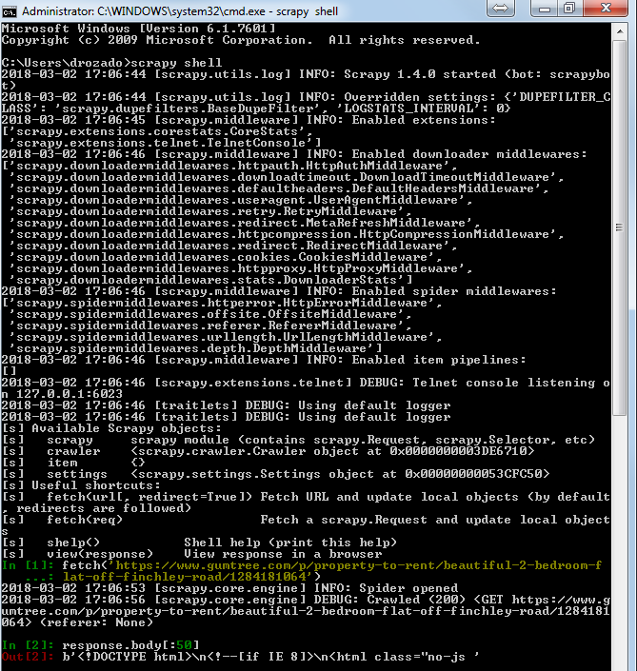
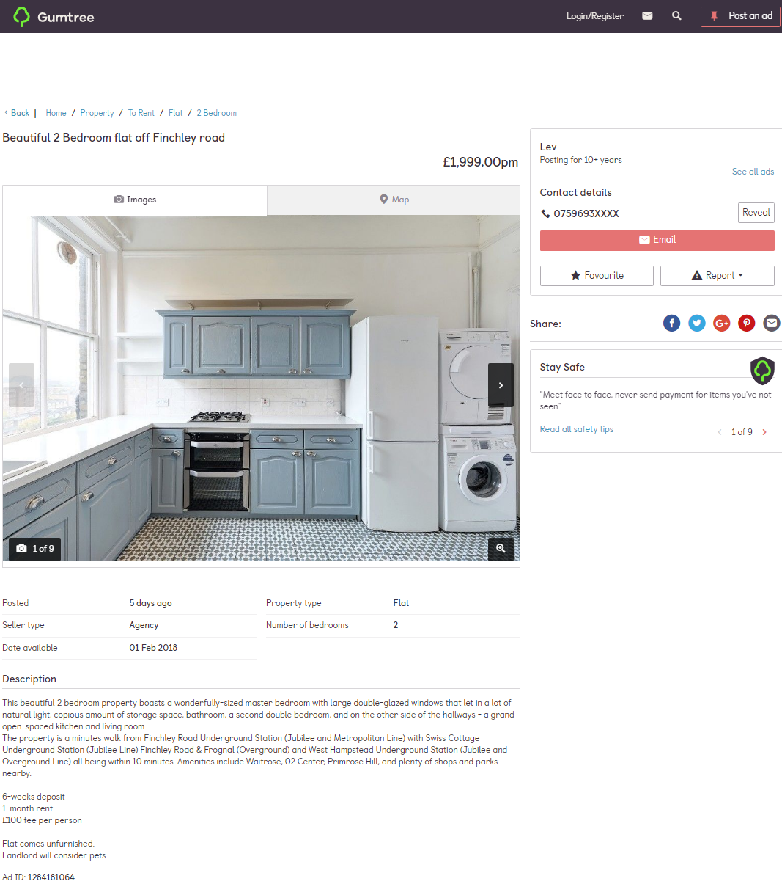
Scrapy shell
https://www.gumtree.com/p/property-to-rent/beautiful-2-bedroom-flat-off-finchley-road/1284181064
It all starts with a URL from the site you want to scrape
The Scrapy shell is an invaluable tool that helps us develop with Scrapy
We gave the Scrapy shell a URL, and it performed a default GET request and got a response with the success code 200. This means that the information from this page is already loaded and ready to be used in the interactive shell in the interactive shell
For illustration purposes I display the first 50 characters of the HTML document contained in the HTTP response object

Slide 21
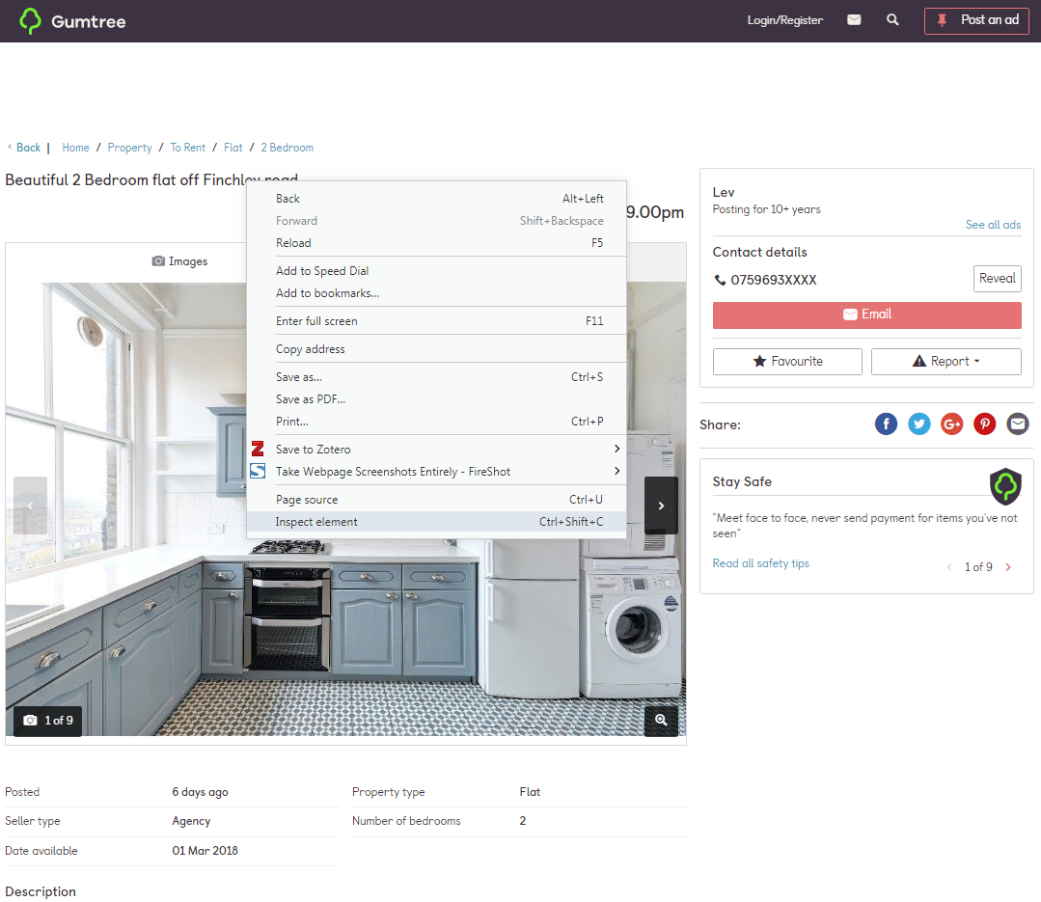
Fetching the data we are interested in
The next step is to try and extract data from the response
Right-click on the title on the page, and select Inspect Element. This takes us to the relevant HTML code.
https://www.gumtree.com/p/property-to-rent/beautiful-2-bedroom-flat-off-finchley-road/1284181064

Slide 22
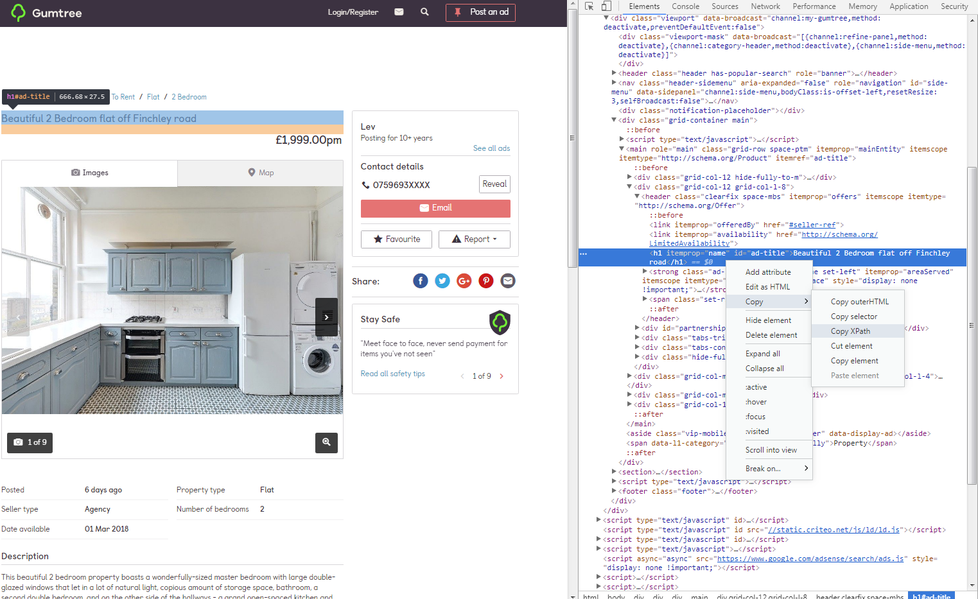
Fetching the data we are interested in
The next step is to try and extract data from the response
Xpath route: //*[@id="ad-title"]

Slide 23
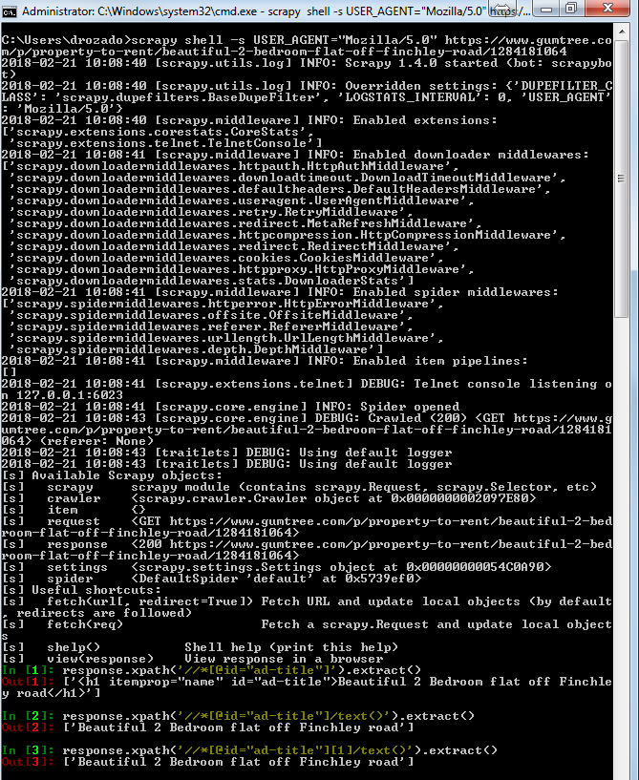
Checking that the XPath expression works with scrapy shell
https://www.gumtree.com/p/property-to-rent/beautiful-2-bedroom-flat-off-finchley-road/1284181064
Notes:
If you are a seasoned programmer, you've probably been used to array[1] being the second element of an array. Surprisingly, XPath is 1-based (!) thus array[1] is the first element of the array.

Slide 24
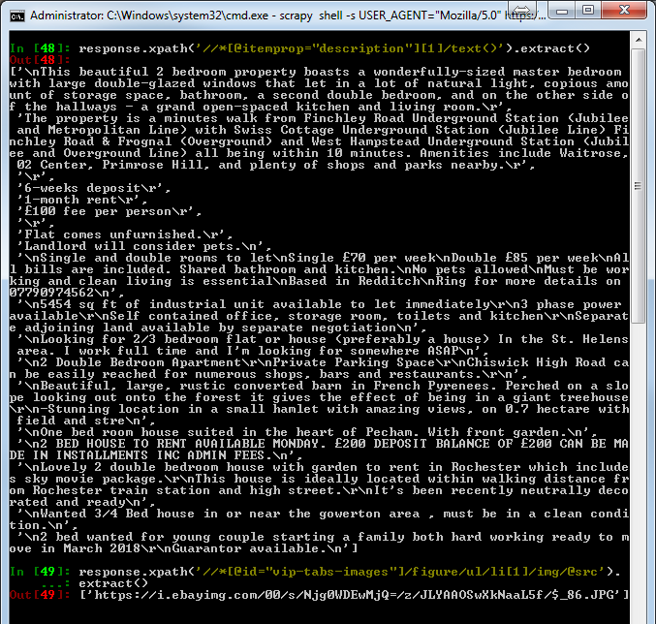
Fetching additional data of interest
Notes:
If you are a seasoned programmer, you've probably been used to array[1] being the second element of an array. Surprisingly, XPath is 1-based (!) thus array[1] is the first element of the array.

Slide 25
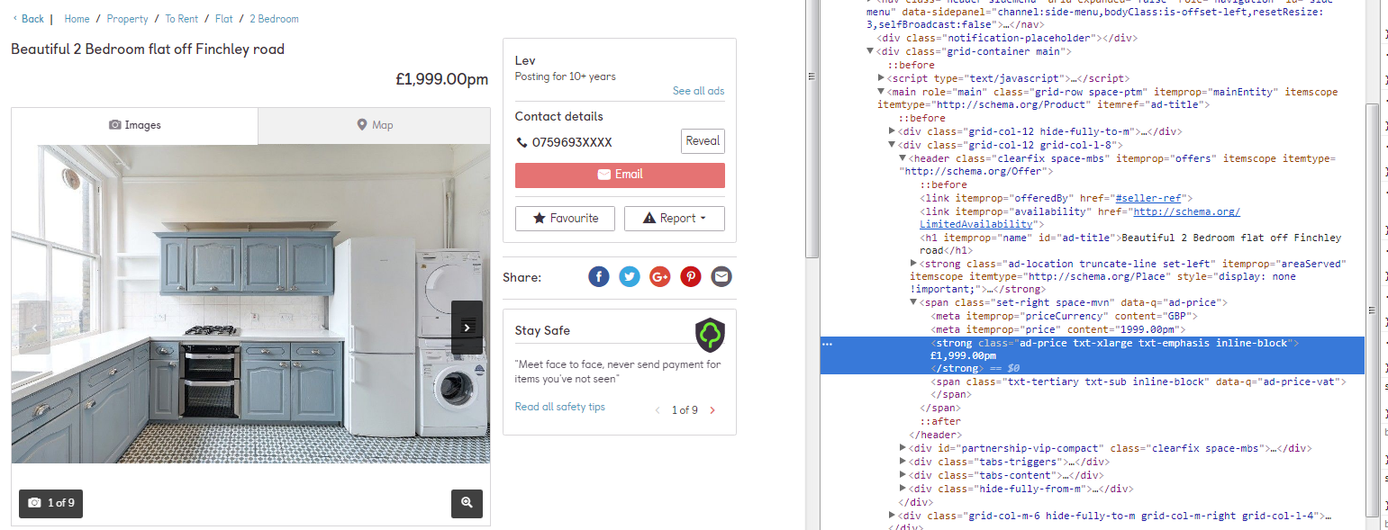
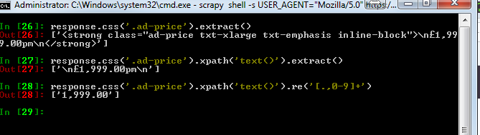
Using CSS selectors to extract data
Notes:
Notice that behind the scenes, css() actually compiles an xpath() expression, but what we type is simpler than the XPath itself. Then we can chain xpath() to extract just the text.
The key point to remember is that xpath() and css() return Selector objects that might be chained. In order to get actual values, use either extract() or re().

Slide 26
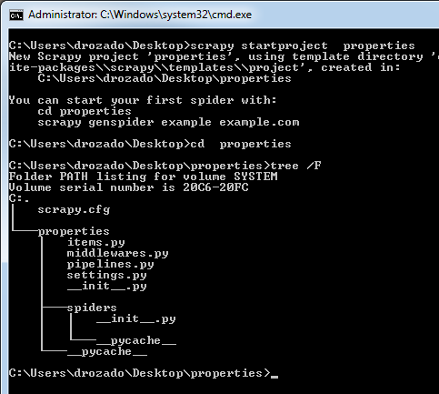
A Scrapy project
Up to now, we were "playing" with Scrapy shell.
Obviously, we don't want to type the code each time we want to crawl something
The Scrapy shell is just a utility to help us play with pages, XPath expressions, and Scrapy objects
Don't invest much time in writing complicated code there, because it's bound to get lost as soon as you exit
In order to write real Scrapy code, we use projects
A project groups Items and spiders
Notes:
Up to now, we were "playing" with Scrapy shell. Now we have all the necessary ingredients to start our first Scrapy project, and we can quit Scrapy shell. Notice that everything you might have typed up to now gets lost. Obviously, we don't want to type the code each time we want to crawl something, so it's important to remember that the Scrapy shell is just a utility to help us play with pages, XPath expressions, and Scrapy objects. Don't invest much time in writing complicated code there, because it's bound to get lost as soon as you exit. In order to write real Scrapy code, we use projects.

Slide 27
Defining items
properties/items.py
The main goal in scraping is to extract structured data from unstructured sources, typically, web pages.
Scrapy spiders can return the extracted data as Python dicts. While convenient and familiar, Python dicts lack structure: it is easy to make a typo in a field name or return inconsistent data, especially in a larger project with many spiders.
To define common output data format Scrapy provides the Item class.
Item objects are simple containers used to collect the scraped data.
from scrapy.item import Item, Field
class PropertiesItem(Item):
# Primary fields
title = Field()
price = Field()
description = Field()
address = Field()
image_urls = Field()
# Calculated fields
images = Field()
location = Field()
# Housekeeping fields
url = Field()
project = Field()
spider = Field()
server = Field()
date = Field()

Slide 28
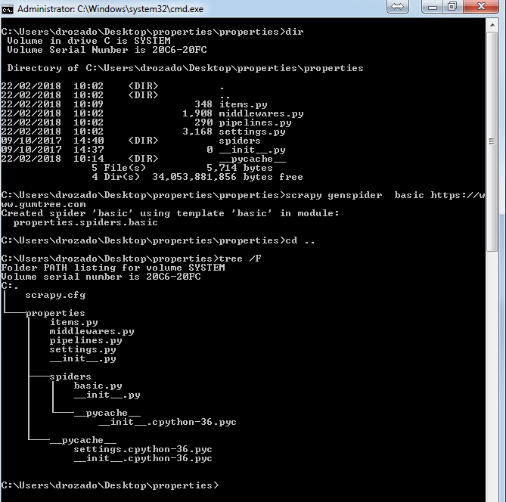
Writing spiders
Spiders are classes which define how a certain site (or a group of sites) will be scraped, including how to perform the crawl (follow links) and how to extract structured data from the pages (scraping items)
Typically, there will be one spider per website
A spider's code implements the whole UR²IM process
What the >scrapy genspider command does is to create a "default" spider with the name "basic“ that is restricted to crawl URLs on the https://www.gumtree.com domain

Slide 29
Spider file
properties/spiders/basic.py
The import statement allows us to use the existing Scrapy framework classes.
After this, it's the definition of a BasicSpider class that extends scrapy.Spider (i.e. this class already "inherits" quite some functionality from the Scrapy framework Spider class)
Then we see some parameters of the spider like its name and the domains that we are allowed to crawl.
We have the definition of an empty function parse()
The object—response is exactly the same response object that we used to play with in the Scrapy shell.
# -*- coding: utf-8 -*-
import scrapy
class BasicSpider(scrapy.Spider):
name = 'basic'
allowed_domains = ['https://www.gumtree.com']
start_urls = ['http://https://www.gumtree.com/']
def parse(self, response):
pass

Slide 30
Spider file
The import statement allows us to use the existing Scrapy framework classes.
After this, it's the definition of a BasicSpider class that extends scrapy.Spider (i.e. this class already "inherits" quite some functionality from the Scrapy framework Spider class)
Then we see some parameters of the spider like its name and the domains that we are allowed to crawl.
We have the definition of an empty function parse()
The object—response is exactly the same response object that we used to play with in the Scrapy shell.
we will use spider's predefined method log() to output the data we are interested in fetching
properties/spiders/basic.py
# -*- coding: utf-8 -*-
import scrapy
class BasicSpider(scrapy.Spider):
name = 'basic'
allowed_domains = ['https://www.gumtree.com']
start_urls = ['https://www.gumtree.com/p/property-to-rent/beautiful-2-bedroom-flat-off-finchley-road/1284181064']
def parse(self, response):
self.log("title: %s" % response.xpath('//h1/text()').extract())
self.log("price: %s" % response.css('.ad-price').xpath('./text()').re('[,.0-9]+')
self.log("description: %s" % response.xpath('//*[@itemprop="description"][1]/text()').extract())
self.log("image_urls: %s" % response.xpath('//*[@itemprop="image"][1]/@src').extract())

Slide 31
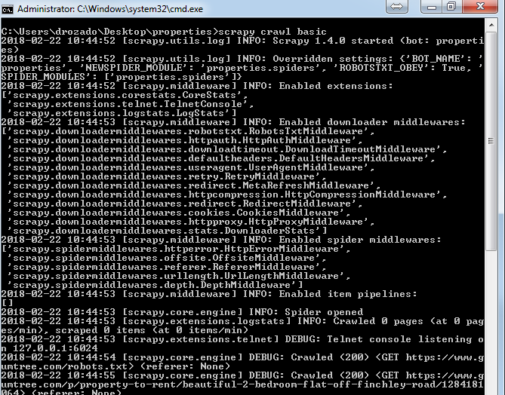
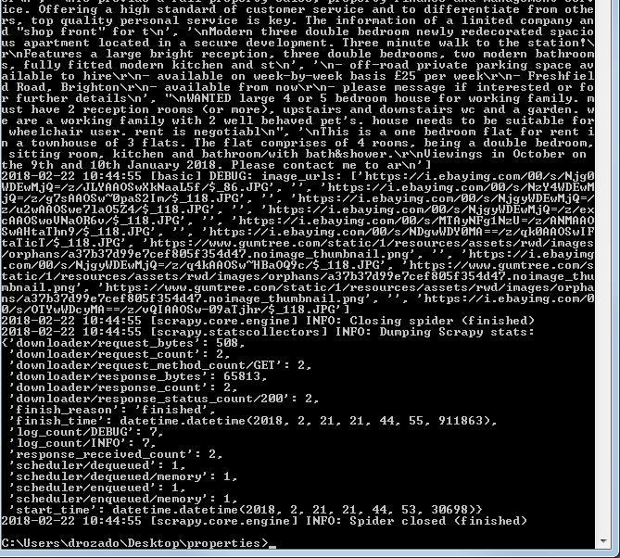
Scrapy crawl
You can start a Scrapy crawl with the following command:
>scrapy crawl basic

Slide 32
Populating an item
We modify the preceding spider code to populate PropertiesItem items and unlock tons of new functionality
We are no longer logging the scraped values
Instead we are scraping data into items objects
properties/spiders/basic.py
# -*- coding: utf-8 -*-
import scrapy
from properties.items import PropertiesItem
class BasicSpider(scrapy.Spider):
name = 'basic'
allowed_domains = ['https://www.gumtree.com']
start_urls = ['https://www.gumtree.com/p/property-to-rent/beautiful-2-bedroom-flat-off-finchley-road/1284181064']
def parse(self, response):
item = PropertiesItem()
item['title'] = response.xpath('//h1/text()').extract()
item['price'] = response.css('.ad-price').xpath('./text()').re('[,.0-9]+')
item['description'] = response.xpath('//*[@itemprop="description"][1]/text()').extract()
item['image_urls'] = response.xpath('//*[@itemprop="image"][1]/@src').extract()

Slide 33
Saving to files
There is no database support built-in for storing scrape data into a database, because it's fundamentally wrong for Scrapy's way of thinking!
Notes:
Without us writing any extra code, we can save on all those different formats.
What happens behind the scenes is that Scrapy recognizes the file extension that you want to output, and exports the file in the appropriate format.
The preceding formats cover some of the most common use cases. CSV, JSON and XML files are very popular
The slight difference between the JSON and the JSON Line format is that the .json files store the JSON objects in a large array. This means that if you have such a file of 1 GB, you might have to store it all in the memory before you parse it with a typical parser. The .jl files on the other hand have one JSON object per line, so they can be read more efficiently.
Where is my MySQL driver?
There is no database support built-in for storing scrape data into a database, because it's fundamentally wrong for Scrapy's way of thinking.
Scrapy is meant to be fast and scalable.
It uses very little CPU and as much inbound bandwidth as possible.
Inserting to most relational databases would be a disaster from the perspective of performance.
When you need to insert your items to a database, you have to store them in files, and then import them using bulk load mechanisms.
That said, Pipelines allow for some efficient ways of importing individual items in databases.

Slide 34
Item loaders
ItemLoaders provide many interesting ways of combining data, formatting them, and cleaning them up
ItemLoaders pass values from XPath/CSS expressions through different processor classes
properties/spiders/basic.py
import scrapy
from properties.items import PropertiesItem
class BasicSpider(scrapy.Spider):
name = 'basic'
allowed_domains = ['https://www.gumtree.com']
start_urls = ['https://www.gumtree.com/p/property-to-rent/beautiful-2-bedroom-flat-off-finchley-road/1284181064']
def parse(self, response):
l = ItemLoader(item=PropertiesItem(), response=response)
l.add_xpath('title','//h1/text()')
l.add_css('price','.ad-price', re='[,.0-9]+')
l.add_xpath('description','//*[@itemprop="description"][1]/text()')
l.add_xpath('image_urls','//*[@itemprop="image"][1]/@src')

Slide 35
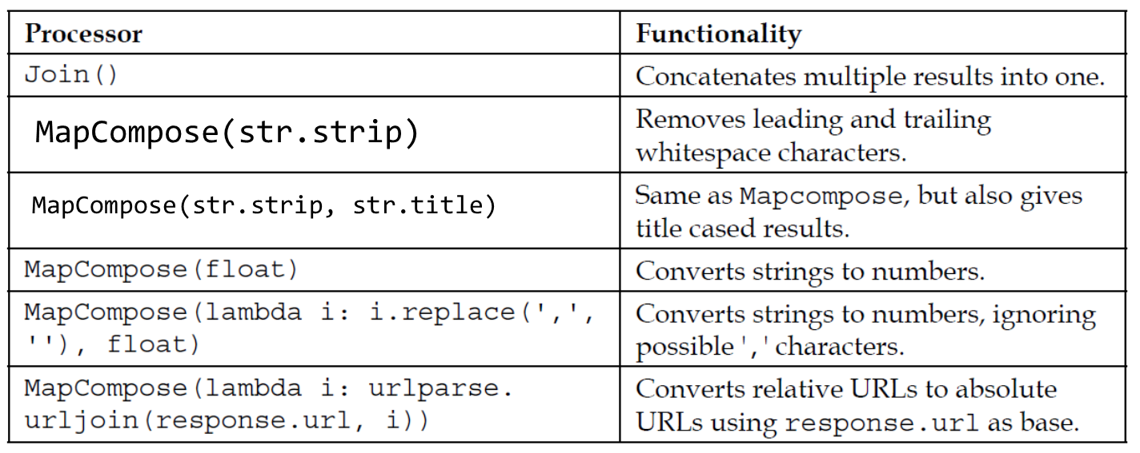
Processors
Processors are fast yet simple functions
The key thing to take away is that processors are just simple and small functions that post-process our XPath/CSS results

Slide 36
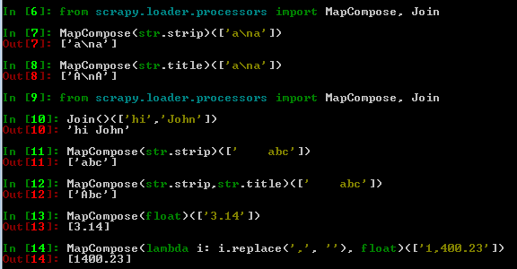
Processors examples
Scrapy shell
properties/spiders/basic.py
l.add_xpath('title','//h1/text()', MapCompose(str.strip, unicode.title))

Slide 37
Extracting more URLs
Up to now, we have been working with a single URL that we set in the spider's start_ urls property.
Since that's a tuple, we can hardcode multiple URLs
But this is not very scalable
properties/spiders/basic.py
start_urls = (
'https://www.gumtree.com/p/garage-parking-to-rent/fantastic-double-garage-available-for-storage-hendon-nw4-/1286959600',
'https://www.gumtree.com/p/property-to-rent/two-bedroom-two-bathroom-second-floor-flat-with-balcony-parking-close-to-transport/1288010111',
'https://www.gumtree.com/p/property-to-rent/five-mins-to-leytonstone-station-three-bed-apartment-available-to-rent-call-07825214488-to-view-/1288044760',
)

Slide 38
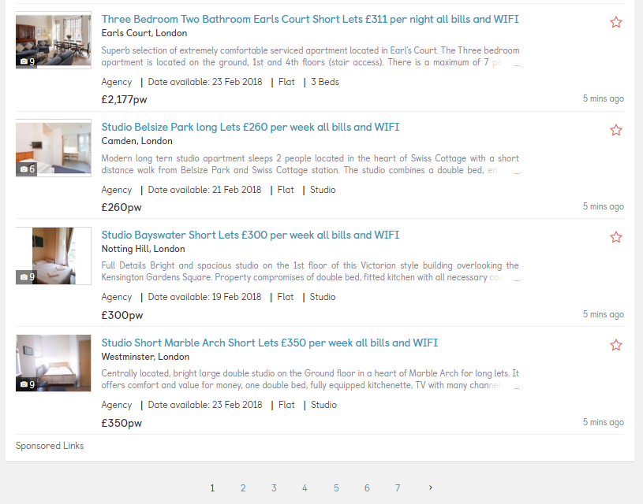
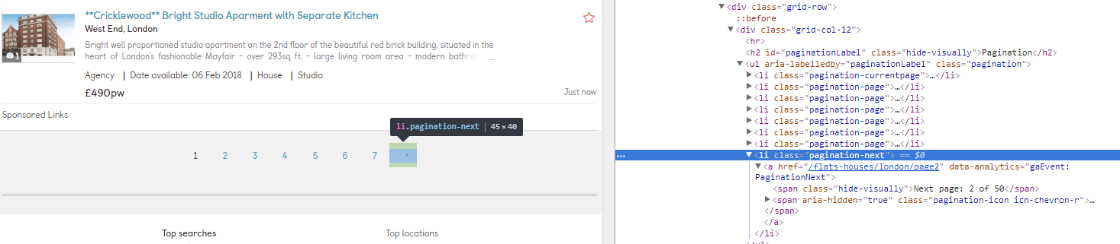
Index pages
http://www.gumtree.com/flats-houses/london
What will happen often is that the website of interests will have some index pages and some listing pages
A typical index page will have some links to many listing pages, and a pagination system that allows you to move from one index page to another
As a result, a typical crawler moves in 2 directions:
Horizontally: from an index page to another
Vertically: from an index page to the listing pages to extract items

Slide 39

Two-direction crawling with a spider
properties/spiders/basic.py
import scrapy
from scrapy.loader.processors import MapCompose, Join
from scrapy.loader import ItemLoader
from scrapy.http import Request
from properties.items import PropertiesItem
class BasicSpider(scrapy.Spider):
name = 'basic'
allowed_domains = ['gumtree.com']
start_urls = ['https://www.gumtree.com/flats-houses/london']
def parse(self, response):
# Get the next index URLs and yield Requests
next_selector = response.xpath('//*[contains(@class,"next")]//@href')
for url in next_selector.extract():
yield scrapy.Request(response.urljoin(url))
# Get item URLs and yield Requests
item_selector = response.xpath('//*[@itemprop="url"]/@href')
for url in item_selector.extract():
yield scrapy.Request(response.urljoin(url),callback=self.parse_item)
def parse_item(self, response):
l = ItemLoader(item=PropertiesItem(), response=response)
l.add_xpath('id','//*[@itemprop="sku"][1]/text()')
l.add_xpath('title','//h1/text()')
l.add_css('price','.ad-price', re='[,.0-9]+')
introDescription = response.xpath('//*[@itemprop="description"][1]/text()').extract_first()
l.add_value('description', introDescription,MapCompose(str.strip), Join())
return l.load_item()
Horizontal crawling
Vertical crawling

Slide 40

Two-direction crawling with a crawl spider
properties/spiders/basic2.py
# -*- coding: utf-8 -*-
import scrapy
from scrapy.loader.processors import MapCompose, Join
from scrapy.linkextractors import LinkExtractor
from scrapy.spiders import CrawlSpider, Rule
from scrapy.loader import ItemLoader
from properties.items import PropertiesItem
class BasicSpider(CrawlSpider):
name = 'basic2'
allowed_domains = ['gumtree.com']
start_urls = ['https://www.gumtree.com/flats-houses/london']
# Rules for horizontal and vertical crawling
rules = (
Rule(LinkExtractor(restrict_xpaths='//*[contains(@class,"next")]')),
Rule(LinkExtractor(restrict_xpaths='//*[@itemprop="url"]'),callback='parse_item')
)
def parse_item(self, response):
l = ItemLoader(item=PropertiesItem(), response=response)
l.add_xpath('id', '//*[@itemprop="sku"][1]/text()')
l.add_xpath('title', '//h1/text()')
l.add_css('price', '.ad-price', re='[,.0-9]+')
introDescription = response.xpath('//*[@itemprop="description"][1]/text()').extract_first()
l.add_value('description', introDescription, MapCompose(str.strip), Join())
return l.load_item()
Notes:
If you felt that this two-direction crawling was a bit too tedious, then you are really getting it. Scrapy tries to simplify all those very common cases, and makes them easier to code. The easiest way to achieve the same results is by using a CrawlSpider, a class that allows easier implementation of such crawls. To do so, we will use the genspider command, setting a -t crawl parameter in order to create a spider using the crawl spider template:
If you see the auto-generated code, it looks similar to the previous spiders but in this case in the class definition, this spider derives from CrawlSpider instead of Spider. CrawlSpider provides an implementation of the parse() method that uses the rules variable to do exactly what we did manually in the previous example.
We won't implement any parse() method this time. We will replace the predefined rules variable instead with two rules, one for horizontal and one for vertical crawling:
rules = (
Basic Crawling
Rule(LinkExtractor(restrict_xpaths='//*[contains(@class,"next")]')),
Rule(LinkExtractor(restrict_xpaths='//*[@itemprop="url"]'),
callback='parse_item')
)
Those two rules use the same XPath expressions we used in the manual example, but without the a or href constraints. As their name implies, LinkExtractors are specialized in extracting links, so by default, they are looking for the a (and area) href attributes. You can customize this by setting the tags and attrs LinkExtractor()'s arguments. Also note that callbacks are now strings containing the callback method name (for example 'parse_item') in contrast to method references, as was the case for Requests(self.parse_item). Finally, unless callback is set, a Rule will follow the extracted URLs, which means that it will scan target pages for extra links and follow them. If a callback is set, the Rule won't follow the links from target pages. If you would like it to follow links, you should either return/yield them from your callback method, or set the follow argument of Rule() to true. This might be useful when your listing pages contain both Items and extra useful navigation links. [ 62 ]

Slide 41
Settings

Slide 42
Settings file
properties/settings.py
# Scrapy settings for properties project
#
# For simplicity, this file contains only settings considered important or
# commonly used. You can find more settings consulting the documentation:
#
# http://doc.scrapy.org/en/latest/topics/settings.html
# http://scrapy.readthedocs.org/en/latest/topics/downloader-middleware.html
# http://scrapy.readthedocs.org/en/latest/topics/spider-middleware.html
BOT_NAME = 'properties'
SPIDER_MODULES = ['properties.spiders']
NEWSPIDER_MODULE = 'properties.spiders'
FEED_EXPORT_FIELDS = ["id","title", "price", "description"]
# Crawl responsibly by identifying yourself (and your website) on the user-agent
USER_AGENT = 'properties (+http://www.yourdomain.com)'
# Obey robots.txt rules
ROBOTSTXT_OBEY = True
# Configure maximum concurrent requests performed by Scrapy (default: 16)
#CONCURRENT_REQUESTS = 32
# Configure a delay for requests for the same website (default: 0)
# See http://scrapy.readthedocs.org/en/latest/topics/settings.html#download-delay
# See also autothrottle settings and docs
DOWNLOAD_DELAY = 3
# The download delay setting will honor only one of:
CONCURRENT_REQUESTS_PER_DOMAIN = 16
CONCURRENT_REQUESTS_PER_IP = 16
# Disable cookies (enabled by default)
COOKIES_ENABLED = False

Slide 43
Being a good citizen in a world full of spiders
There are a few things one needs to be aware of while developing scrapers.
Irresponsible web scraping can be annoying and even illegal in some cases. The three most important things to avoid are
denial-of-service (DoS) attack like behavior
violating copyrights
Ignoring robots.txt directives
In the first one, a typical visitor might be visiting a new page every few seconds. A typical web crawler might be downloading tens of pages per second. That is more than ten times the traffic that a typical user generates. This might reasonably make the website owners upset. Use throttling to reduce the traffic you generate to an acceptable user-like level. Monitor the response times, and if you see them increasing, reduce the intensity of your crawl. The good news is that Scrapy provides out-of-the-box implementation of both these functionalities
On copyrights, obviously, take a look at the copyright notice of every website you scrape, and make sure you understand what is allowed and what is not. Most sites allow you to process information from their site as long as you don't reproduce them claiming that it's yours. What is nice to have is a User-Agent field on your requests that allows webmasters to know who you are and what you do with their data. Scrapy does this by default by using your BOT_NAME as a User-Agent when making requests.
Another important aspect is allowing any webmaster to prevent you from accessing certain areas of their website. Scrapy provides functionality (RobotsTxtMiddleware) that respects their preferences as expressed on the web-standard robots.txt file (see an example of that file at http://www.google.com/robots.txt).

Slide 44
References
Xpath cheatsheets:
https://devhints.io/xpath
http://scraping.pro/res/xpath-cheat/xpath_css_dom_recipes.pdf
http://scraping.pro/res/xpath-cheat/xpath_css_dom_ref.pdf
Xpath tutorials:
https://data-lessons.github.io/library-webscraping/xpath/
http://plasmasturm.org/log/xpath101/ (concise, very good!)

